Slide 1
Guess the intruder
Project presentation
Dialogue Systems, SS 2025
Christina Klironomou

Slide 2
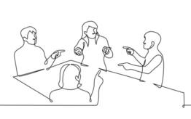
The game
Already existing live-action game
Each person has a secret identity (in a specific common context); except one
Yes-no questions:
-Intruder: find the context / not being spot on
-Everyone else: find the intruder
Speechstate version (mine): 6 people (5 people of the context and 1 intruder) impersonated by the computer. The user has to guess who the intruder is.
Yes-no questions

Slide 3
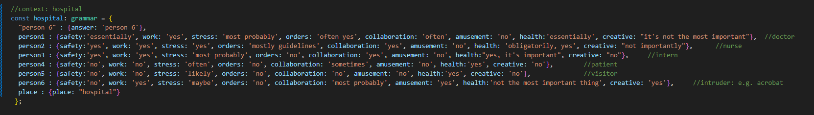
Resources
Speechstate and Typescript
NLU entities: general categories for a variety of questions (e.g. “work” -> “Do you work in that place?”, “Do you have a job in this context?”, “Are you working there?”)
Different grammars for each context (hospital, theater etc), grammar entries for each person, with values corresponding to each entity
Azure: NLU entities
HTML and CSS for the appearance/design

Slide 4
Challenges
? Robust characters (lack of extra-linguistic cues)
? Memory restrictions (verbal information overload, not distinguishable characters)
? Only 3 contexts – intruder on a fix position
More questions
Printing of the answers of the already-asked questions / Different voices
More contexts – randomize the position of the intruder

Slide 5
Brainstorming
Lab 2: basic structure of states, how to store utterance values, how to create and check a grammar
Lab 4: entities (flexibility of the utterances: what makes this game possible)
Lab 3 (potential): different voices among the 6 people
Statecharts logic: helpful (implementation not strongly based on hierarchical state relations / no state chart created for the game [mental representation of the state transitions])

Slide 6
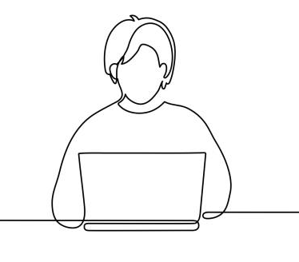
Testing
- Speech-based: causes anxiety to the user to think fast
- No entries for all the users’ questions
- Still a bit confusing (especially without displaying information)
+ Fun
+ Good recognition of entities (enough variations of a potential question)

Slide 7

Ethical concerns
Subjectivity of the answers (also in the live-action game)
-> Instructions: the user is discouraged to ask subjective questions (“Do you like your job” etc)
Stereotypical representations of professions/roles

